Slide 1


Quantum State Tomography of a Single Qubit
Suttavee Rojanasirivanit 6105115
Poramat Chianvichai
Natdhanai Praneenatthavee 6105048
Khunakorn Wongsriprasert 6005014

Slide 2

Outline
Introduction
Single Qubit
Quantum State Tomography
Methodology
Direct inversion tomography (DIT)
Minimum distance (MD)
Maximum Fidelity (MFD)
Conclusion

Slide 3

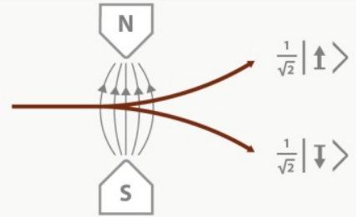
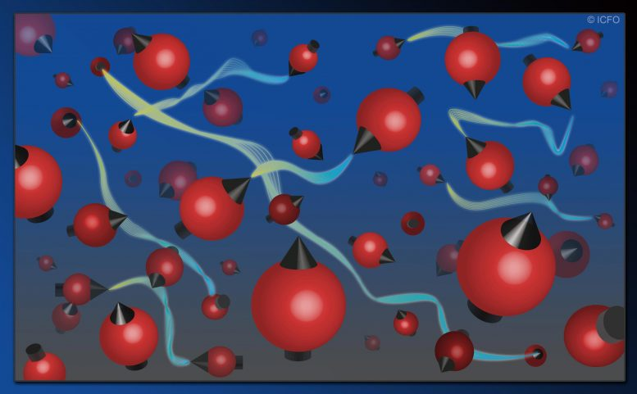
Single Qubit
The simplest quantum systems that exist in any quantum superposition of two independent quantum states.
A very well-known example of qubit is the spin-1/2 of an electron

Slide 4

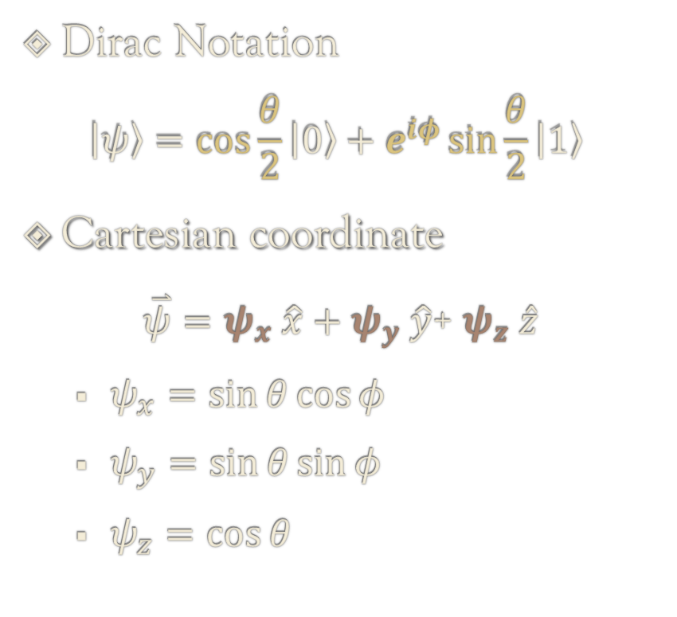
Math Representation of Single Qubit
Bloch sphere
Dirac Notation
$$\left|ψ\right\rangle =\cos{\frac{θ}{2}}\left|0\right\rangle +e^{iφ}\sin{\frac{θ}{2}}\left|1\right\rangle$$
Cartesian coordinate
$\overset{⃑}{ψ}=ψ_{x} \hat{x}+ψ_{y} \hat{y}$+ $ψ_{z} \hat{z}$
$ψ_{x}=\sin{θ}\cos{φ}$
$ψ_{y}=\sin{θ}\sin{φ}$
$ψ_{z}=\cos{θ}$

Slide 5
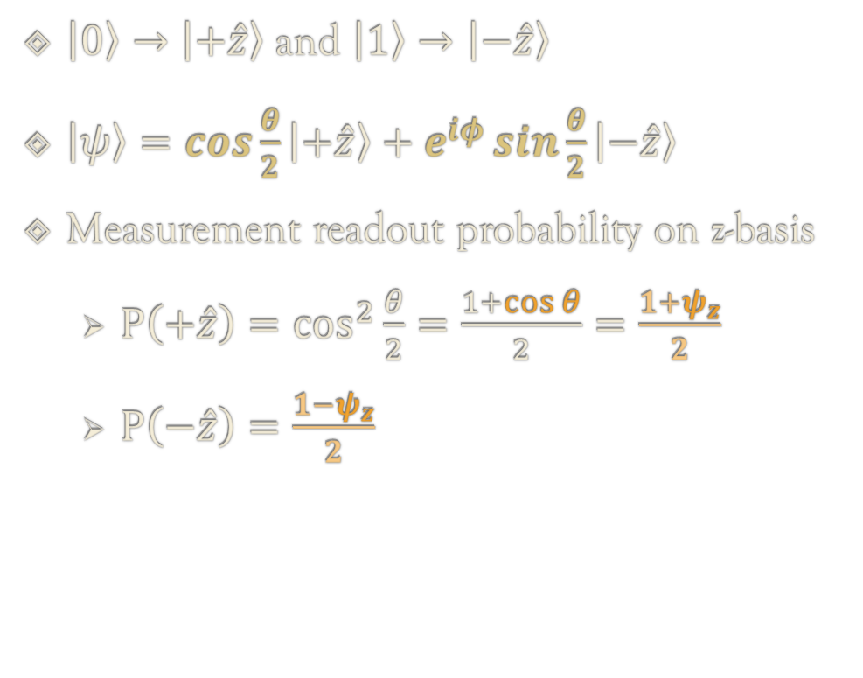
Single Qubit Measurement
$\left|0\right\rangle →\left|+\hat{z}\right\rangle$ and $\left|1\right\rangle →\left|−\hat{z}\right\rangle$
$\left|ψ\right\rangle =\cos{\frac{θ}{2}\left|+\hat{z}\right\rangle +e^{iφ}\sin{\frac{θ}{2}}}\left|−\hat{z}\right\rangle$
Measurement readout probability on z-basis
$P\left(+\hat{z}\right)=\cos^{2}{\frac{θ}{2}}=\frac{1+\cos{θ}}{2}=\frac{1+ψ_{z}}{2}$
$P\left(−\hat{z}\right)=\frac{1−ψ_{z}}{2}$

Slide 6
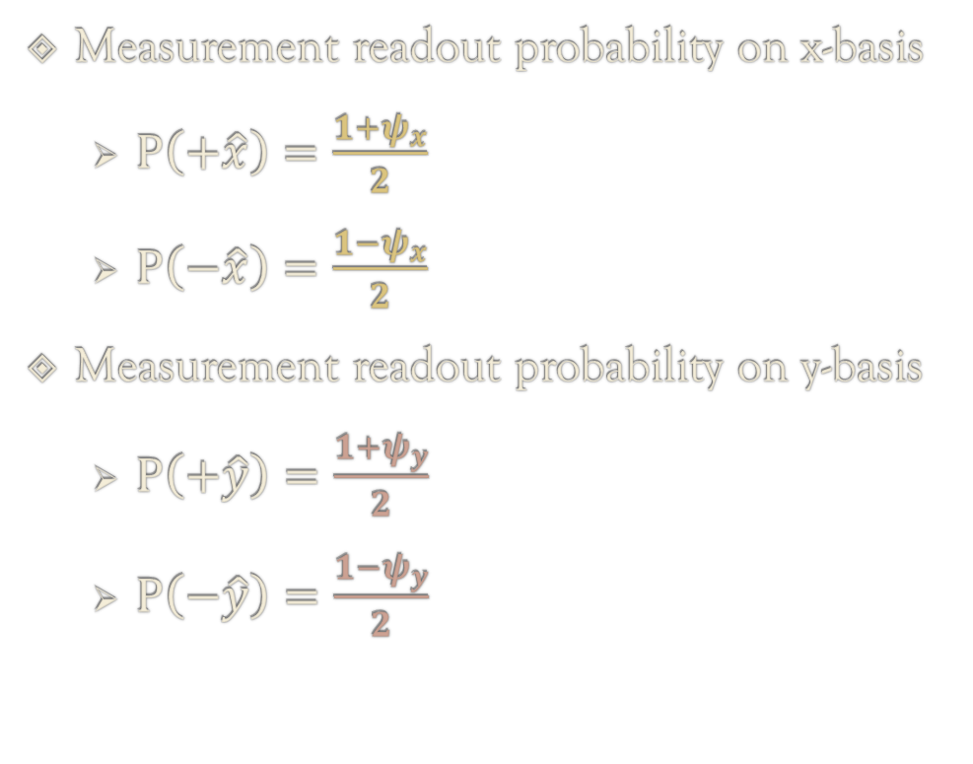
Single Qubit Measurement
Measurement readout probability on x-basis
$P\left(+\hat{x}\right)=\frac{1+ψ_{x}}{2}$
$P\left(−\hat{x}\right)=\frac{1−ψ_{x}}{2}$
Measurement readout probability on y-basis
$P\left(+\hat{y}\right)=\frac{1+ψ_{y}}{2}$
$P\left(−\hat{y}\right)=\frac{1−ψ_{y}}{2}$

Slide 7

Quantum State Tomography
The process to identify the unknown quantum state using measurements on an ensemble of identical quantum states.
Prepare quantum state
Measurement with chosen basis
Collect a measurement readout
Identify the unknown quantum state
Notes:
Reconstruct or identify

Slide 8
1.Direct inversion tomography (DIT)

Slide 9
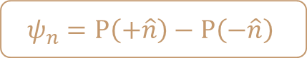
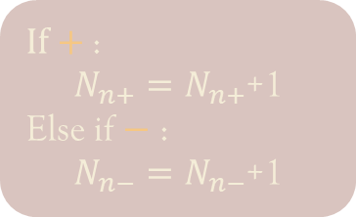
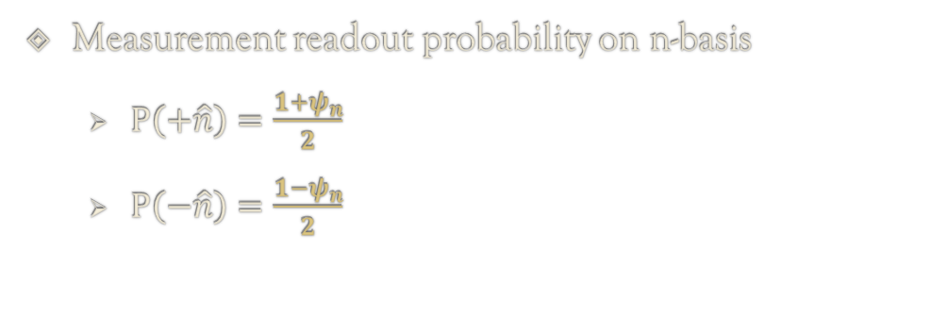

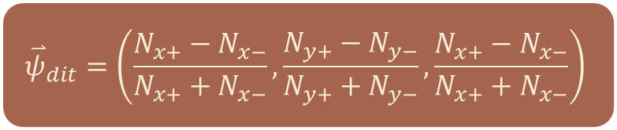


1.Direct inversion tomography (DIT)
Start with
$$N_{x+}=N_{x−}=N_{y+}=N_{y−}=N_{z+}=N_{z−}=0$$
Measurement readout probability on n-basis
$P\left(+\hat{n}\right)=\frac{1+ψ_{n}}{2}$
$P\left(−\hat{n}\right)=\frac{1−ψ_{n}}{2}$
$$ψ_{n}=P\left(+\hat{n}\right)−P\left(−\hat{n}\right)$$
Prepare a single qubit state
*$n∈\left\{x,y,z\right\}$
Measurement with $n$ basis
If + :
$N_{n+}=N_{n+}$+1
Else if $−$ :
$N_{n−}=N_{n−}$+1
$${\overset{⃑}{ψ}}_{dit}=\left(\frac{N_{x+}−N_{x−}}{N_{x+}+N_{x−}},\frac{N_{y+}−N_{y−}}{N_{y+}+N_{y−}},\frac{N_{x+}−N_{x−}}{N_{x+}+N_{x−}}\right)$$

Slide 10
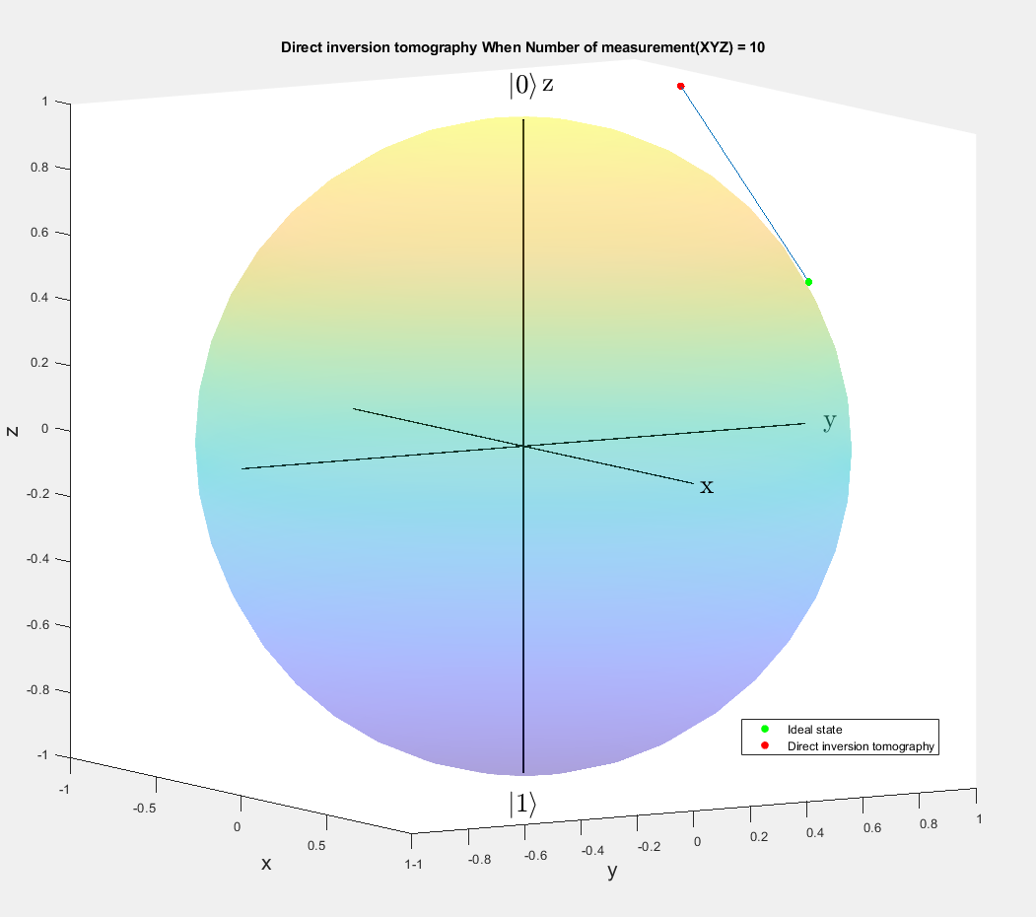
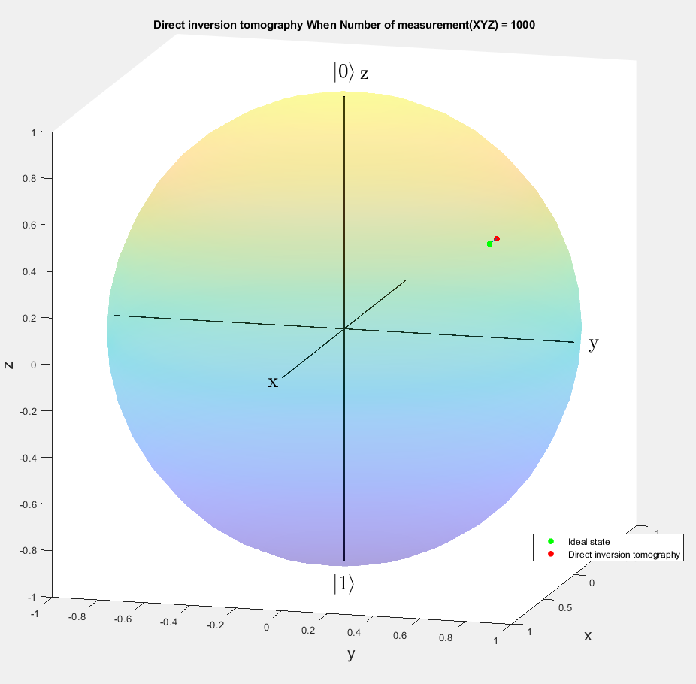
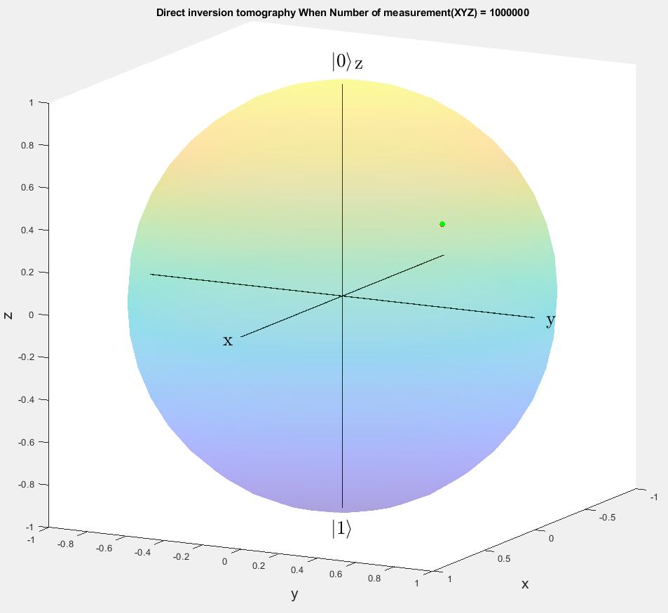
Direct inversion tomography result
XYZ 10 times
XYZ 1,000 times
XYZ 1,000,000 times

Slide 11
2.Minimum distance (MD)

Slide 12
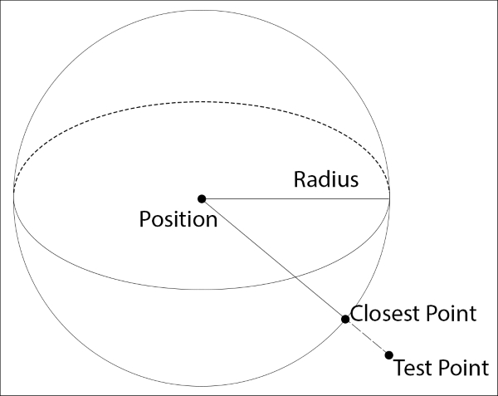
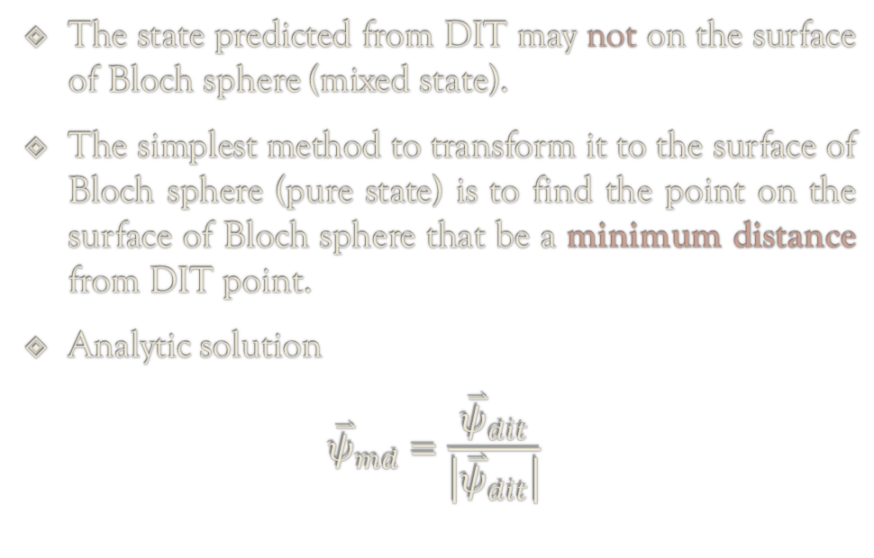
2.Minimum distance (MD)
The state predicted from DIT may not on the surface of Bloch sphere (mixed state).
The simplest method to transform it to the surface of Bloch sphere (pure state) is to find the point on the surface of Bloch sphere that be a minimum distance from DIT point.
Analytic solution
$${\overset{⃑}{ψ}}_{md}=\frac{{\overset{⃑}{ψ}}_{dit}}{\left|{\overset{⃑}{ψ}}_{dit}\right|}$$

Slide 13



Gradient descent
Gradient descent is a first-order iterative optimization algorithm for finding a local minimum of a differentiable function.
$$w_{new}=w_{old}−α\frac{∂cost}{∂w}$$
*$α$ is learning rate

Slide 14


Slide 15
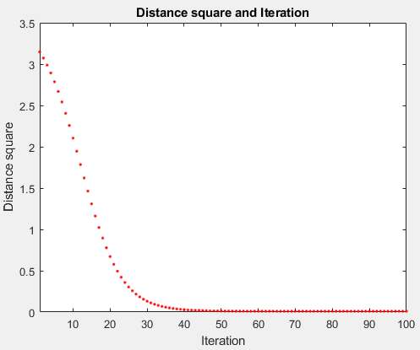
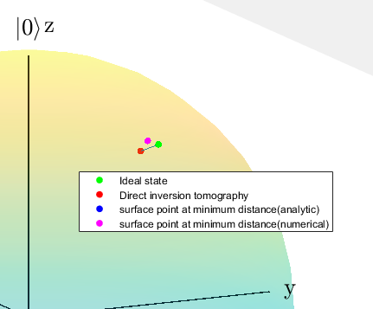
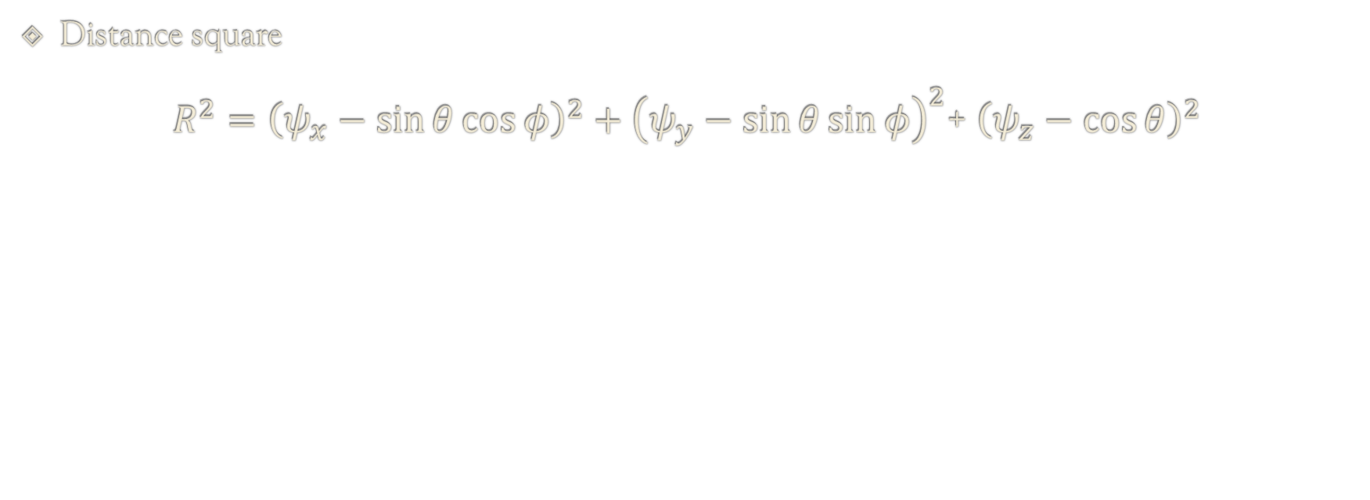
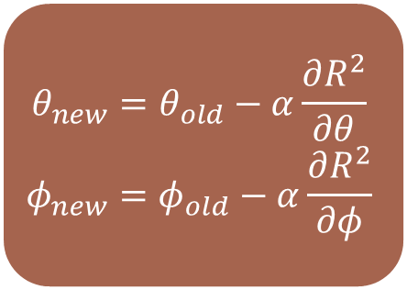
MD using Gradient descent
Distance square
$R^{2}={\left(ψ_{x}−\sin{θ}\cos{φ}\right)}^{2}+{\left(ψ_{y}−\sin{θ}\sin{φ}\right)}^{2}$+ ${\left(ψ_{z}−\cos{θ}\right)}^{2}$
$$θ_{new}=θ_{old}−α\frac{∂R^{2}}{∂θ}$$
$$φ_{new}=φ_{old}−α\frac{∂R^{2}}{∂φ}$$

Slide 16
3.Maximum fidelity

Slide 17
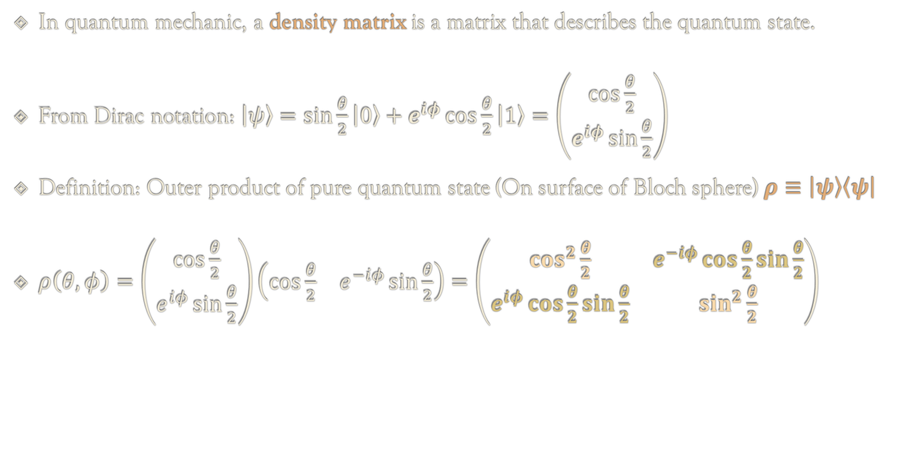
Density matrix of pure state
In quantum mechanic, a density matrix is a matrix that describes the quantum state.
From Dirac notation: $\left|ψ\right\rangle =\sin{\frac{θ}{2}}\left|0\right\rangle +e^{iφ}\cos{\frac{θ}{2}}\left|1\right\rangle =\left(\begin{aligned}\cos{\frac{θ}{2}} \\ e^{iφ}\sin{\frac{θ}{2}}\end{aligned}\right)$
Definition: Outer product of pure quantum state (On surface of Bloch sphere) $ρ≡\left|ψ\right\rangle \left\langle ψ\right|$
$ρ\left(θ,φ\right)=\left(\begin{aligned}\cos{\frac{θ}{2}} \\ e^{iφ}\sin{\frac{θ}{2}}\end{aligned}\right)\left(\begin{matrix}\cos{\frac{θ}{2}} & e^{−iφ}\sin{\frac{θ}{2}}\end{matrix}\right)=\left(\begin{matrix}\cos^{2}{\frac{θ}{2}} & e^{−iφ}\cos{\frac{θ}{2}}\sin{\frac{θ}{2}} \\ e^{iφ}\cos{\frac{θ}{2}}\sin{\frac{θ}{2}} & \sin^{2}{\frac{θ}{2}}\end{matrix}\right)$

Slide 18
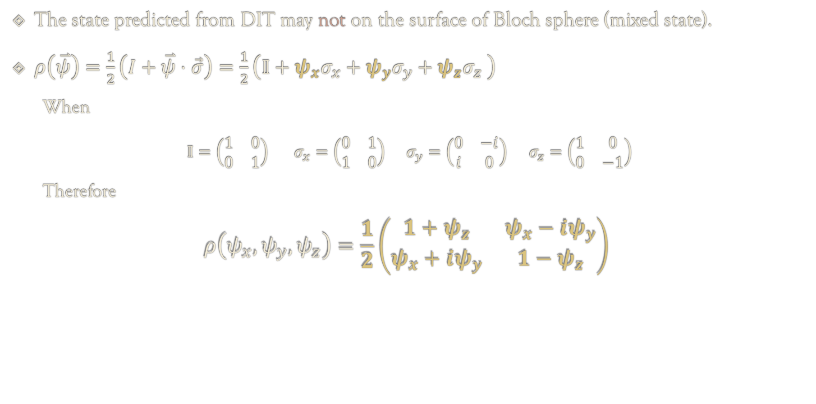
Density matrix from cartesian coordinate
The state predicted from DIT may not on the surface of Bloch sphere (mixed state).
$ρ\left(\overset{⃑}{ψ}\right)=\frac{1}{2}\left(I+\overset{⃑}{ψ}⋅\vec{σ}\right)=\frac{1}{2}\left(𝕀+ψ_{x}σ_{x}+ψ_{y}σ_{y}+ψ_{z}σ_{z} \right)$
When
$𝕀=\left(\begin{matrix}1 & 0 \\ 0 & 1\end{matrix}\right)$ $σ_{x}=\left(\begin{matrix}0 & 1 \\ 1 & 0\end{matrix}\right)$ $σ_{y}=\left(\begin{matrix}0 & −i \\ i & 0\end{matrix}\right)$ $σ_{z}=\left(\begin{matrix}1 & 0 \\ 0 & −1\end{matrix}\right)$
Therefore
$$ρ\left(ψ_{x},ψ_{y},ψ_{z}\right)=\frac{1}{2}\left(\begin{matrix}1+ψ_{z} & ψ_{x}−iψ_{y} \\ ψ_{x}+iψ_{y} & 1−ψ_{z}\end{matrix}\right)$$

Slide 19
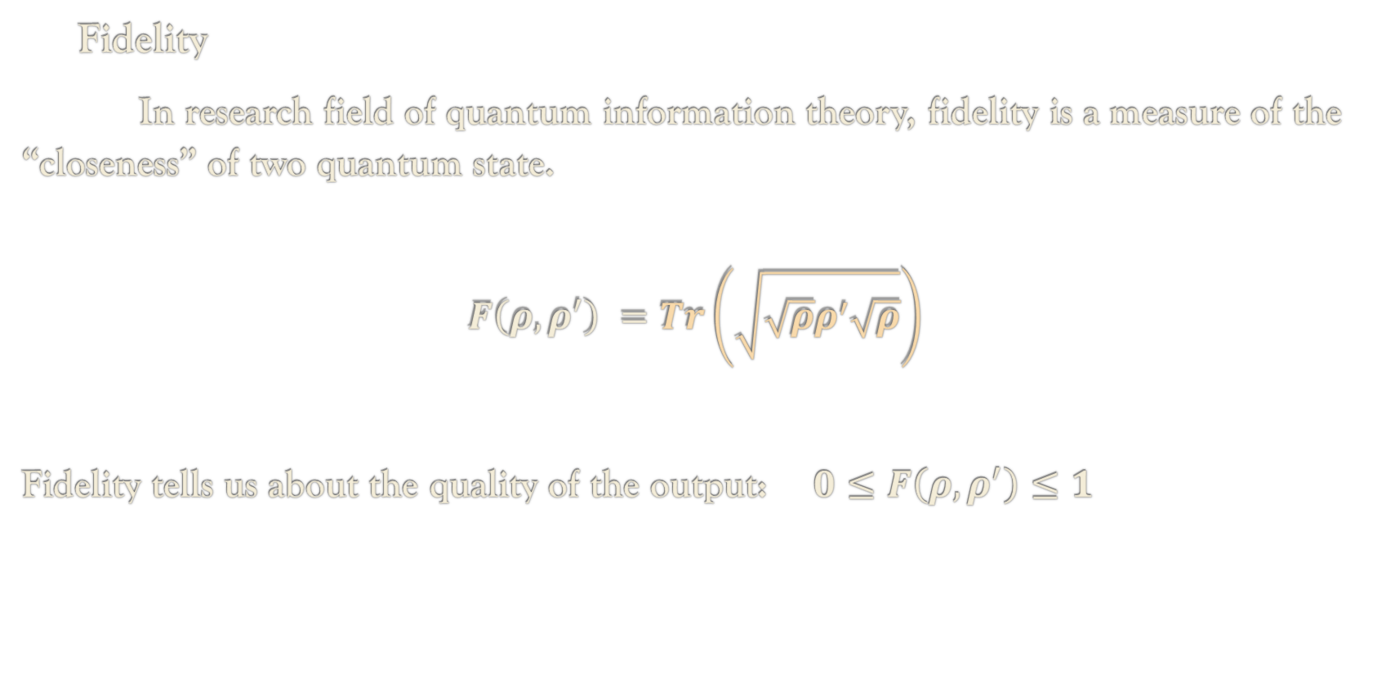
3.Maximum fidelity
Fidelity
In research field of quantum information theory, fidelity is a measure of the “closeness” of two quantum state.
$$F\left(ρ,ρ^{′}\right) =Tr\left(\sqrt{\sqrt{ρ}ρ^{′}\sqrt{ρ}}\right)$$
Fidelity tells us about the quality of the output: $0≤F\left(ρ,ρ^{′}\right)≤1$
desired output
Fidelity
actual output
Actual output is orthogonal to the desired output
Actual output is the same as the desired output

Slide 20
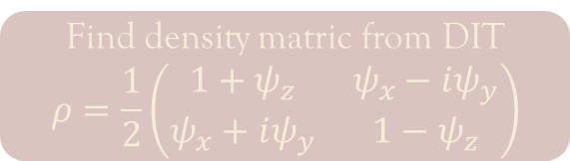
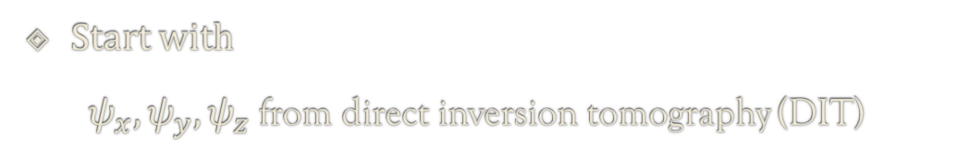
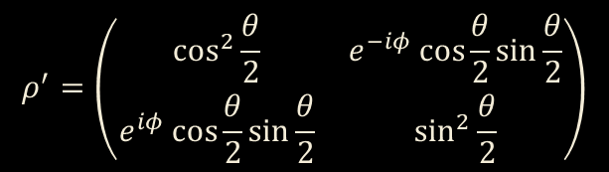


Algorithm that used in maximum fidelity
Start with
$ψ_{x},ψ_{y},ψ_{z}$from direct inversion tomography (DIT)
Find $ρ′$ from $θ,φ$
Find density matric from DIT
$$ρ=\frac{1}{2}\left(\begin{matrix}1+ψ_{z} & ψ_{x}−iψ_{y} \\ ψ_{x}+iψ_{y} & 1−ψ_{z}\end{matrix}\right)$$
$$ρ^{′}=\left(\begin{matrix}\cos^{2}{\frac{θ}{2}} & e^{−iφ}\cos{\frac{θ}{2}}\sin{\frac{θ}{2}} \\ e^{iφ}\cos{\frac{θ}{2}}\sin{\frac{θ}{2}} & \sin^{2}{\frac{θ}{2}}\end{matrix}\right)$$
Condition : theta <=180 ?
True
Condition : phi <=360 ?
True
Find fidelity
$$F\left(ρ, ρ′\right) =Tr\left(\sqrt{\sqrt{ρ}ρ^{′}\sqrt{ρ}}\right)$$
False
Theta +=1
Phi +=1
Program End

Slide 21
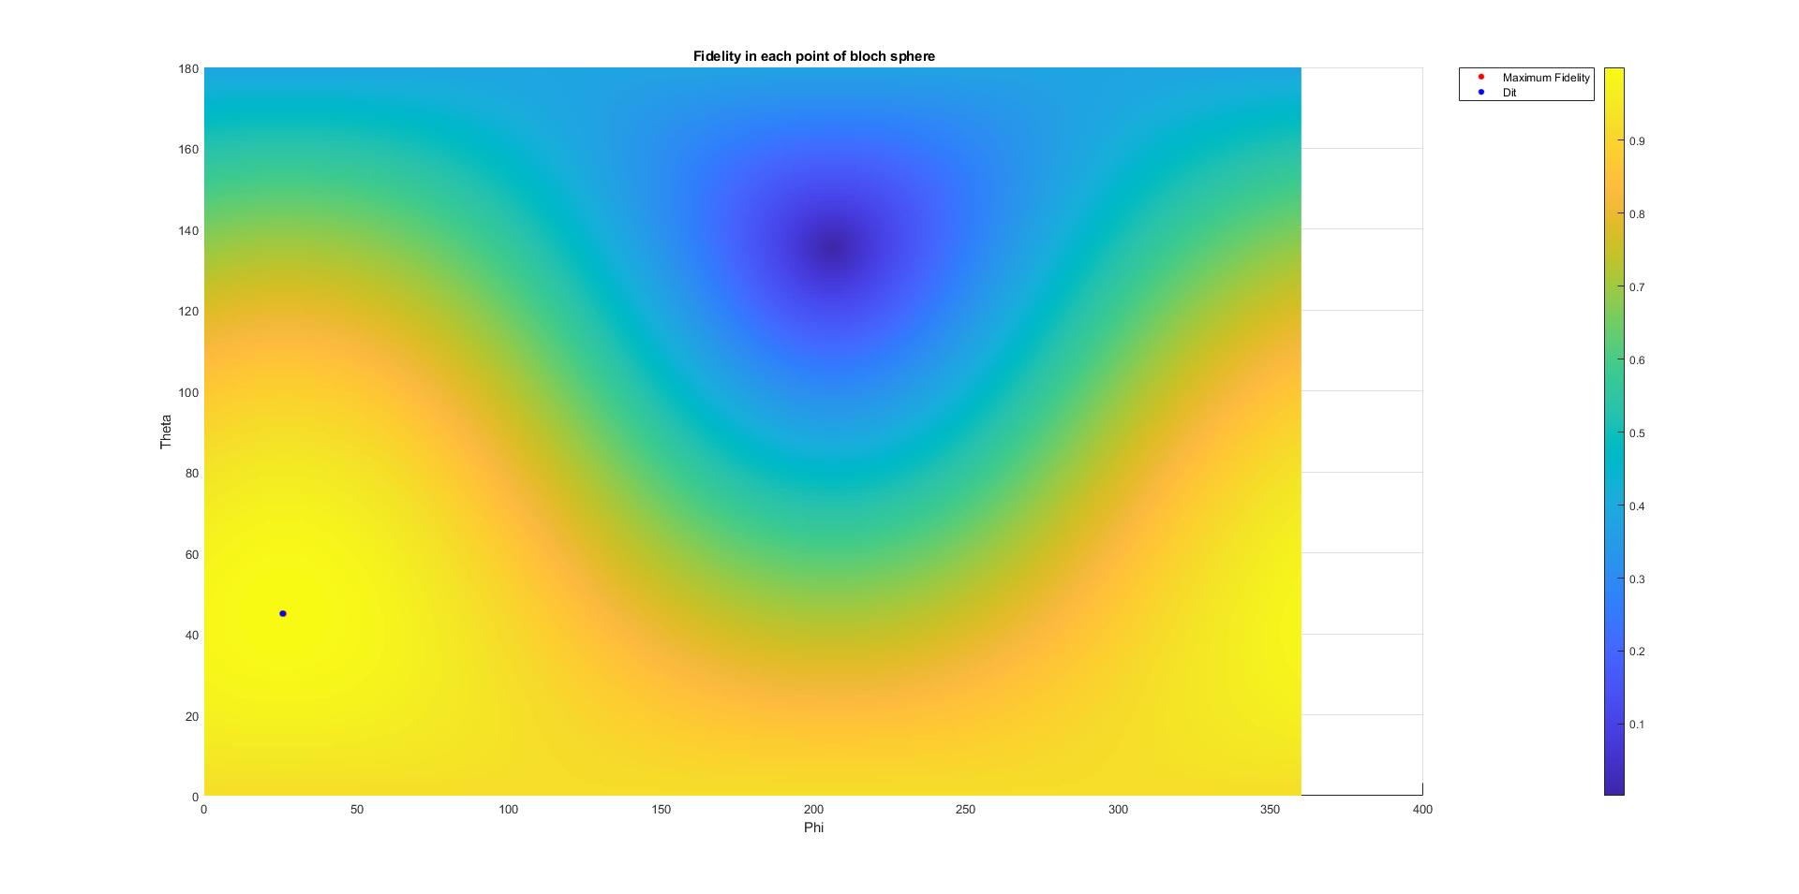
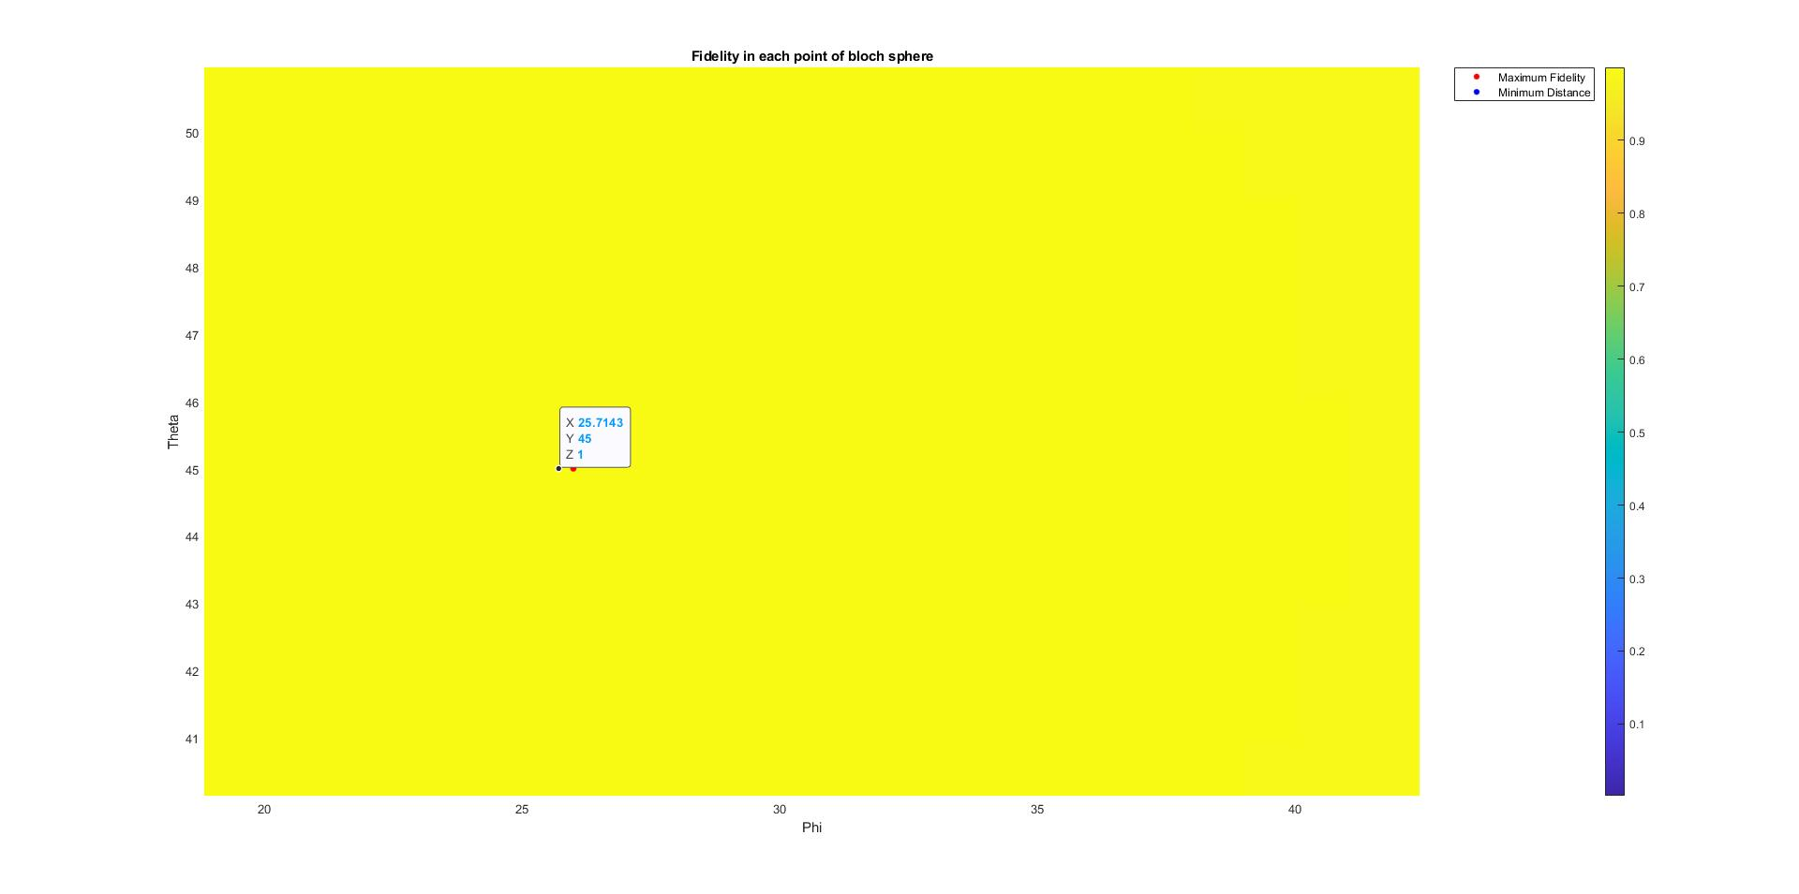

Result of Maximum fidelity

Slide 22
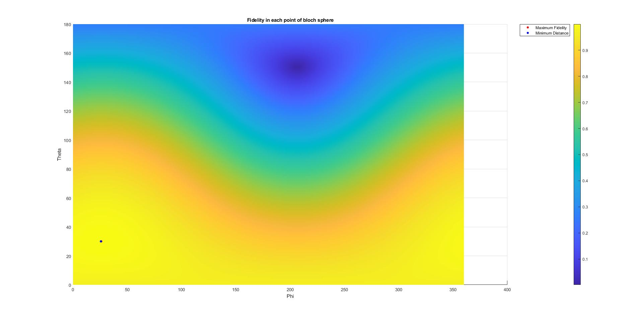
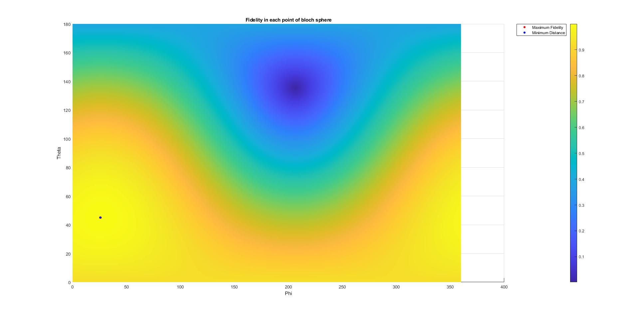
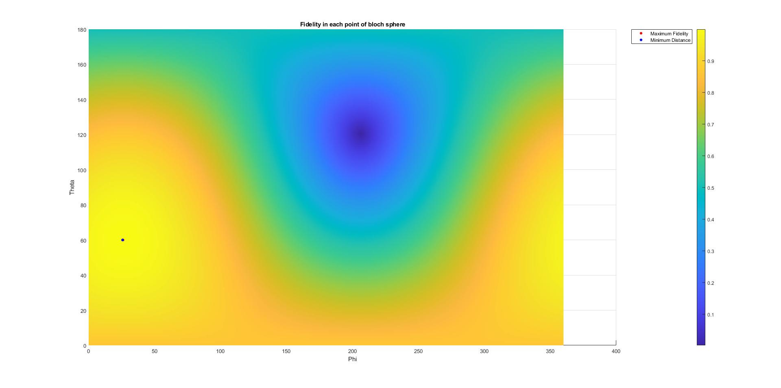
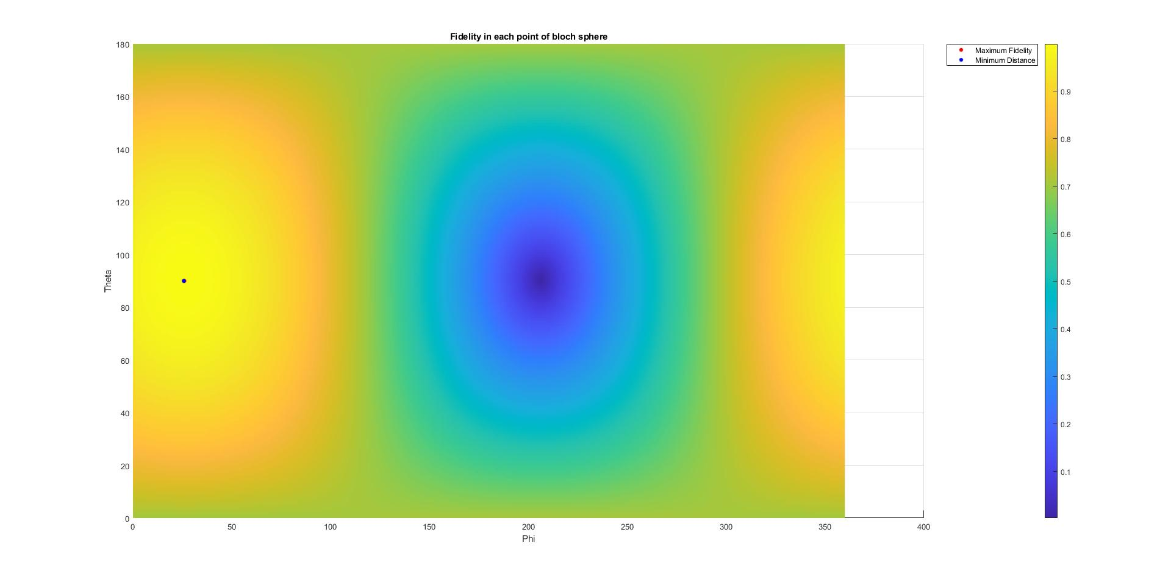
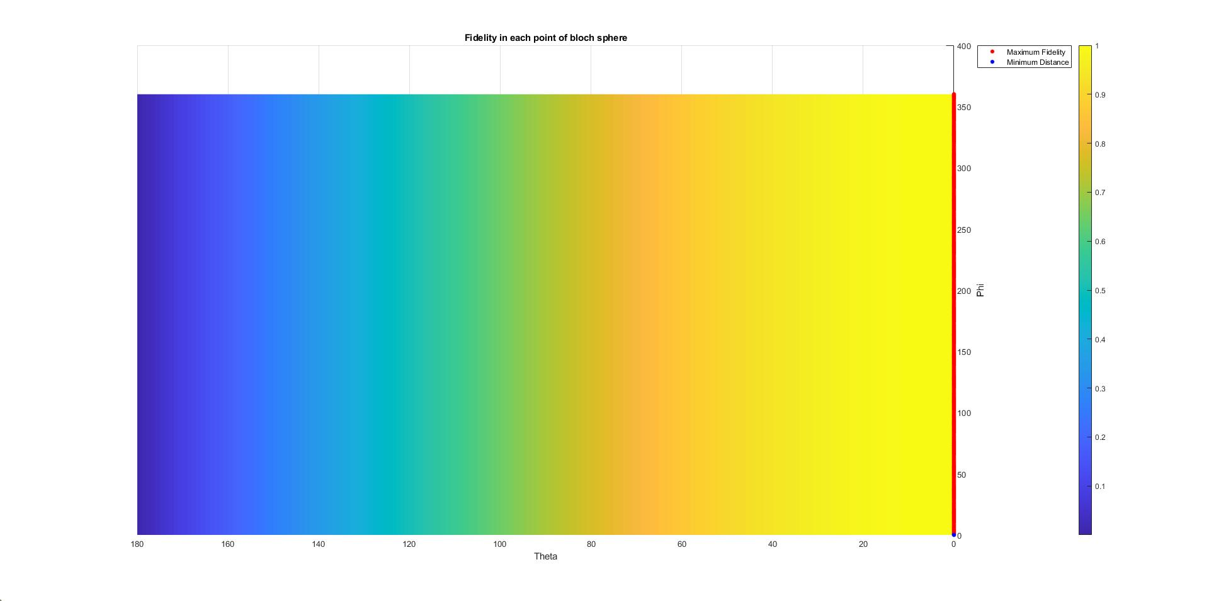





Result from different theta
$$θ=\frac{π}{6}$$
$$θ=\frac{π}{4}$$
$$θ=\frac{π}{3}$$
$$θ=\frac{π}{2}$$
$$θ=0$$

Slide 23
Conclusion
run main.m

